Slide 1
Ordering Adjectives
I can order adjectives in sentences
according to conventional patterns.

Slide 2
What are adjectives?
Adjectives are words that describe or tell about nouns or pronouns.
Adjectives make sentences more interesting.
They give details that make your meaning clearer.
They tell what kind or how many.

Slide 3
Highlight the adjectives in the sentences.
Seven ghastly goblins haunted the young children.
We saw many pumpkins glowing orange that scary night.
My blonde wig didn’t match my costume, so I had to buy one black wig for fourteen dollars.

Slide 4
Which sentence sounds better?
The old green wicked witch cackled out loud.
The green wicked old witch cackled out loud.

Slide 5
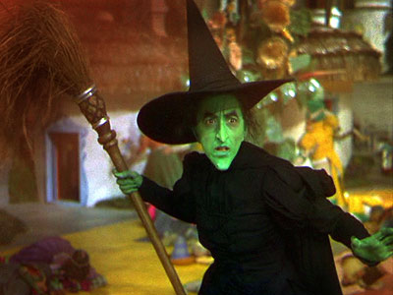
Adjectives have an ORDER!

Slide 6
Ordering Adjectives
opinion
size
age
shape
color
origin
material
purpose

Slide 7
Ordering Adjectives
An opinion adjective explains what you think about something (other people may not agree with you).
For example: silly, beautiful, horrible, difficult
Halloween opinion adjectives???

Slide 8
Ordering Adjectives
A size adjective, of course, tells you how big or small something is.
For example: large, tiny, enormous, little

Slide 9
Ordering Adjectives
An age adjective tells you how young or old something or someone is.
For example: ancient, new, young, old

Slide 10
Ordering Adjectives
A shape adjective describes the shape of something.
For example: square, round, flat, rectangular

Slide 11
Ordering Adjectives
A color adjective, of course, describes the color of something.
For example: blue, pink, reddish, gray

Slide 12
Ordering Adjectives
An origin adjective describes where something comes from.
For example: French, lunar, American, eastern, Greek

Slide 13
Ordering Adjectives
A material adjective describes what something is made from.
For example: wooden, metal, cotton, paper

Slide 14
Ordering Adjectives
A purpose adjective describes what something is used for. These adjectives often end with “-ing”.
For example: sleeping (as in “sleeping bag”), catching (as in “catching mitt”)

Slide 15
Some Examples of Adjective Order
OPINION | SIZE | AGE | SHAPE | COLOR | ORIGIN | MATERIAL | PURPOSE | NOUN
silly |  | young |  |  | English |  |  | man
 | huge |  | round |  |  | metal |  | bowl
 | small |  |  | red |  |  | sleeping | bag
 |  | old |  | green |  |  | wicked | witch

Slide 16
Ordering Adjectives
Click here to practice.

Slide 17
On your own…
Write a sentence using three or more adjectives IN ORDER.
gigantic
four
orange
roasted
scary
round
farm-raised

